Slide 1
Topic 3
Cell movement

Slide 2
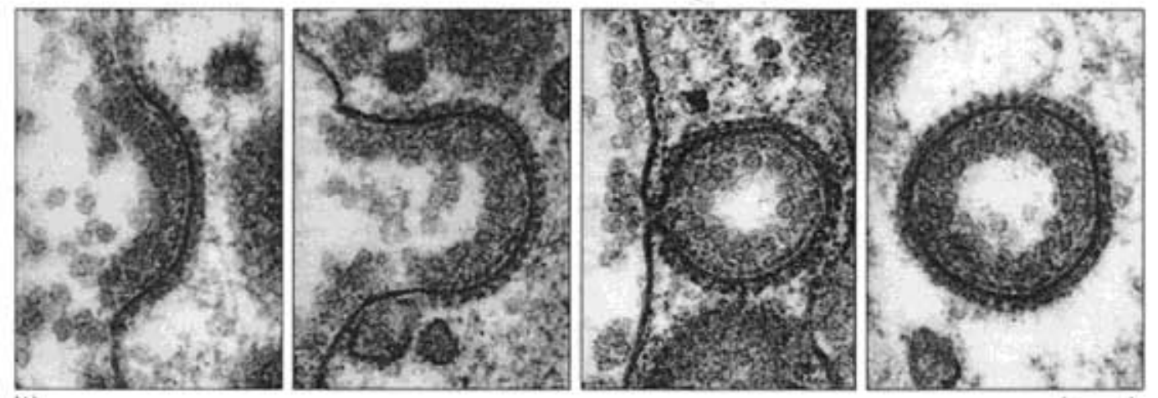
Lecture 3 - Endocytosis
To the left is a figure of a (x1) coated vesicle. This is an example of receptor-mediated (x2). In this process, the vesicle itself is made up of a (x3) with (x1) embedded throughout.
x1:
x2:
x3:
Notes:
Clathrin
Endocytosis
Phospholipid bilayer

Slide 3
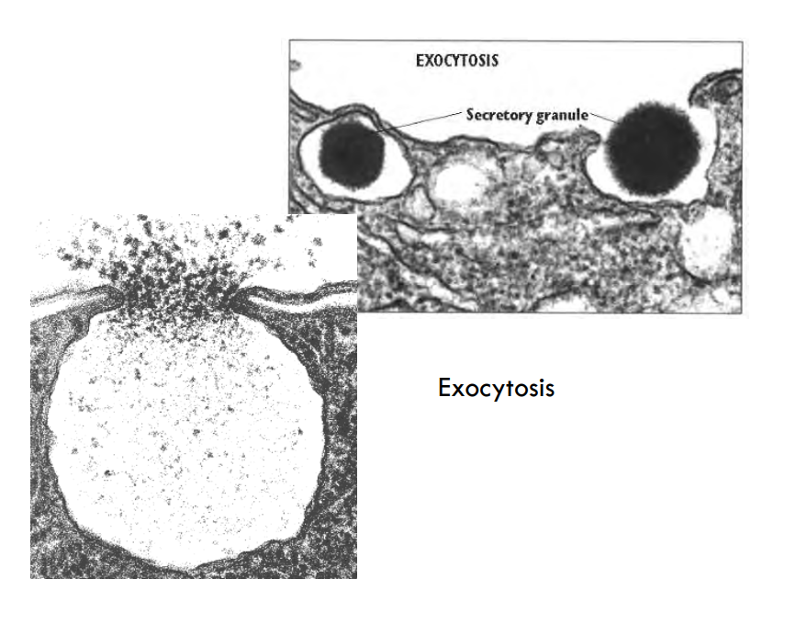
Quickfire terminology
Process of a cell ‘engulfing’ another cell
Process of a cell encapsulating something from outside the cell
Process of a cell releasing contents from within (E.g. the process of degranulation)
Granulocytes can release chemicals e.g. histamine in response to certain events (E.g. inflammation). Histamine is initially stored in vesicles and are released when the granulocytes are activated.
What is the name of the process the cell undergoes to degranulate?

